Slide 1
ENERGY Conservation
Ravindra Datar
By
Senergy Consultants (P) Ltd
ravi@senergy.co.jn
www.senergy.india.com

Slide 2
Can I contribute?
Why should I contribute?
How can I contribute?

Slide 3
Each one of us
can
Contribute!

Slide 4
Switching ON gadgets if & Only if
Required
Lights & fans
Computers
Air Conditioning system
Pumps , Elevators & other Auxiliaries

Slide 5
Being observant about
Consumption during non-working periods
Changes in the consumption / usage patterns
Part load operation
Losses & unaccounted consumption

Slide 6
Consumption during non-working periods
Office Premises – Power
Factory – Pump
Lighting - Single Switch
Lighting - Street / Parking Area

Slide 7
Changes in consumption / usage patterns
Overall Consumption
Air Compressors
Water Pumps
Air Conditioning System

Slide 8
Part Load Operation
Centralized Air Conditioning System
Air Compressors

Slide 9
Losses & Unaccounted Consumption
Cable Losses
Power Theft
Faulty Meters
Unmonitored consumption

Slide 10
Why
must
I
Contribute?

Slide 11
It Cost Money!
Tube Light | Rs 800/- to Rs 1,200/- per year
Fan | Rs 1,200/- to Rs 1,600/- per year
Computer | Rs 1,000/- to Rs 4,000/- per year
Air Conditioner (1 TR) | Rs 20,000/- to 40,000/- per year
Water Heater (1 kW) | Rs 20,000/- per year
Power Cost of Rs 8.0 per unit | Operation of 2,500 hours a year

Slide 12
It depletes Natural Resources
Tube Light | 100 to 250 kg of coal per year
Fans | 120 to 160 kg of coal per year
Computers | 150 to 600 kg of coal per year
Air Conditioner (1 TR) | 3,000 to 6,000 kg of coal per year
Water Heater (1 kW) | 3,000 kg of coal per year
Generation & Distribution Efficiency of 18% | Operation of 2,500 hours a year

Slide 13
Fossil Fuels
World & India’s Reserves
Fossil
World’s Reserves
India’s Reserves
% of World Reserves
Remarks on Indian Reserves
Coal
984 billion tonnes
84,414 million tonnes
8%
will last for 200 years
Crude Oil
140.4 billion tonnes
658 million tonnes
0.46%
will last for 16 years
Natural Gas
144.8 trillion cubic meter
628 billion cubic meters
0.43%
will last for 23 years

Slide 14
It adds to Global Warming
Tube Light | 200 to 500 kg of CO₂ per year
Fans | 240 to 320 kg of CO₂ per year
Computers | 300 to 1,200 kg of CO₂ per year
Air Conditioner (1 TR) | 6,000 to 12,000 kg of CO₂ per year
Water Heater (1 kW) | 6,000 kg of CO₂ per year
Generation & Distribution Efficiency of 18% | Operation of 2,500 hours a year

Slide 15
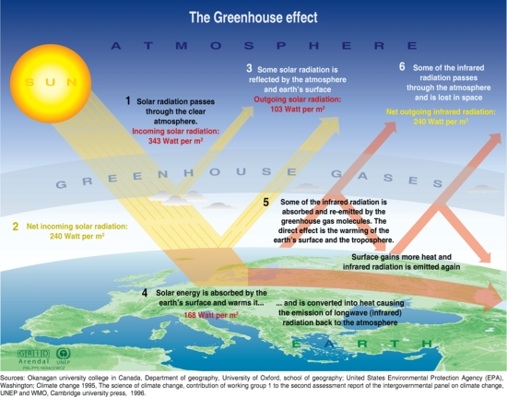

Slide 16
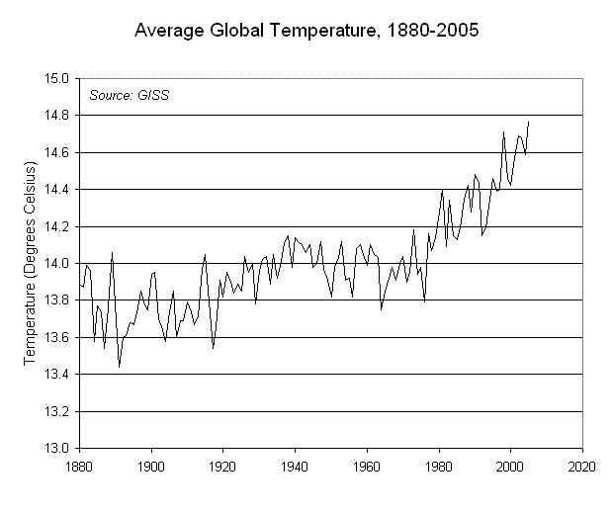

Slide 17
How
can
I
Contribute?

Slide 18
Take Initiative – Bell the CAT
Switch ON if & only if REQUIRED
Be ALEART! Check for Deviations / Changes.
Set thermostat on the highest comfortable temperature.
Use daylight, wherever possible

Slide 19
Fundamentals

Slide 20
Efficient Equipments.
Minimal Distribution Losses.
Proficient Operation & Maintenance.
Effective Utilization.
Recovery of Waste Energy

Slide 21
Efficient Equipments
Equipment | Normal | Most Efficient
Air Conditioner | 1.5 kWh/TR | 0.9 kWh/TR
Tube Light | 65 Lumen/Watt | 110 Lumen/Watt
Ballast for tube light | 15 W | 3 W with 10% more light
Glass | 100% heat gain | 10 to 20% heat gain

Slide 22
Minimal Distribution Losses
Cables / Switchgear of correct Specifications . (Electricity Boards lose 40 to 50% in Transmission & distribution .)
Capacitors at key locations.
Regular cleaning / maintenance of the switch gear.
Balancing of load.

Slide 23
Proficient Operation & Maintenance
Regular Cleaning of filters of indoor units.
Maintaining correct quantity of refrigerant.
Regular cleaning fins, radiators and fan blades of outdoor units.
Periodic maintenance of luminaries.

Slide 24
Effective Utilization
Setting thermostat at the maximum comfortable temperature.
Maintaining correct illumination level.
Switching off equipments in un-occupied areas.

Slide 25
Recovery of Waste Energy
Heat pump for simultaneous generation of hot & cold water.
Biogas from canteen waste.

Slide 26
Air Conditioners

Slide 27
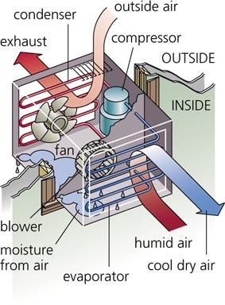
Window Air Conditioner
Notes:
Determine the best close for your audience and your presentation. Close with a summary; offer options; recommend a strategy; suggest a plan; set a goal. Keep your focus throughout your presentation, and you will more likely achieve your purpose.

Slide 28
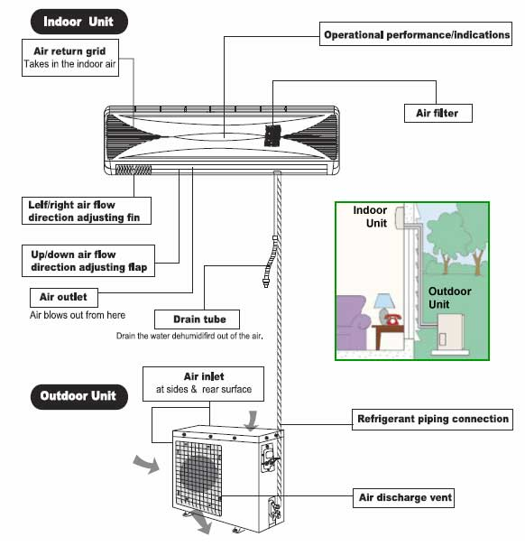
Split Air Conditioner
Notes:
Determine the best close for your audience and your presentation. Close with a summary; offer options; recommend a strategy; suggest a plan; set a goal. Keep your focus throughout your presentation, and you will more likely achieve your purpose.

Slide 29
Effect of Temperature
Evaporator Temperature | Condenser Temperature
 |  | +40⁰ | +50⁰
+5⁰C | TR | 1.43 | 1.27
 | Power (kW) | 1.02 | 1.17
 | kW/TR | 0.72 | 0.93
0⁰C | TR | 1.18 | 1.04
 | Power (kW) | 0.968 | 1.09
 | KW/TR | 0.82 | 1.05
-5⁰C | TR | 0.96 | 0.84
 | Power (kW) | 0.896 | 0.994
 | KW/TR | 0.93 | 1.19

Slide 30
Each 1 ºC increase in thermostat setting saves 3 to 5% in power. It also drops capacity by 1.5 to 2%.
Each 1 ºC rise in condensing temperature increases power by 5 to 6%. It also reduces capacity by 3 to 4%.
Solar rays directly falling on the condenser can increase power by 5 to 15%. It shall also reduce capacity by 3 to 10%.

Slide 31
Heat load on Air Conditioners
Human beings – 20 to 40% of load
Heat ingress from windows – Up to 0.8 TR/M²/day.
Heat gain through ceiling – Up to 1.5 TR/M²/day.
Heat ingress through openings.
Heat gain through walls, window frames, doors
Heat load from computers , printers & lighting.

Slide 32
Lighting

Slide 33
Light Sources
Description | Rating W | Efficacy Lumen/W | CRI | Life Hour
Incandescent Bulb | 12 to 500 | 8 to 17 | 100% | 1000
Fluorescent Tube Light | 5 to 65 | 50 to 110 | 65 to 80% | 5000
Compact Fluorescent Lamp | 5 to 65 | 40 to 70 | 70 to 80% | 8000
High Pressure Mercury Vapour | 80 to 1000 | 25 to 50 | 50% | 8000 to 10000
High Pressure Sodium Vapour | 70 to 1000 | 60 to 90 | 40% | 12000
Metal Halide | 70 to 250 | 70 to 80 | 80% | 10000
LED Lamps | 0.1 to 100 | 60 to 140 | 80 to 100% | 50000 to 100000

Slide 34
Illumination Level
General | 20 to 50 Lux | Outdoor, stores, Yards
Interior | 50 to 200 Lux | Warehouse, Dining Hall, Lobby
Office | 150 to 250 Lux | Office work / Reading room
Workshop & Drawing | 300 to 500 Lux | Inspection & Drawing
Task | 500 & Above | Visually difficult task

Slide 35
Computers

Slide 36
CPU
Description | Tower | Laptop
Maximum | 150 W | 75 W
Average | 120 W | 60 W
Idle | 80 W | 40 W
Stand by / Hibernate | 15 W | 3 to 5 W
Power Supply | 10 W | 6 W

Slide 37
Monitor
Parameter | CRT | LCD
Consumption | 76 W | 25 W
Screen colour | Highly Sensitive. | Insensitive.
Brightness | Moderately sensitive. | Sensitive.
Contrast | Sparingly | Insensitive.
 | sensitive.
Turned off - Power Setting | 2W | 0 W
Screen Saver Mode consumes similar power.

Slide 38
Printers & Scanners
Description | Power
Idle | 10 W
Scanning | 15 W
Printing | 35 W

Slide 39
Road Ahead
Monitoring & Control
Equipment Maintenance
Heat ingress
Hall conditions
Energy Saving gadgets
Usage of daylight

Slide 40
Monitoring & Control
Day to day consumption
Consumption during non-working period
Performance of Air Conditioners
Hall Conditions
Switching ON if & only If required

Slide 41
Equipment Maintenance
Filter cleaning
Refrigerant Quantity
Radiator cleaning
Cleaning of luminaries

Slide 42
Heat Ingress
Films / coating for glass - Reject 75% of solar heat.
Coating for Ceiling - Reradiate 85% of solar heat.
Outdoor units in Shade / with Plant cover .
Plug leakages / gaps to arrest leakages.
Computers - TFT & Effective Power Management system.

Slide 43
Hall Conditions
Maintain Highest comfortable Temperature.
Switch Off, if not occupied.

Slide 44
Energy Saving Gadgets
Intelligent Energy saver for A Cs – saves 15 to 25% energy.
Timer based Energy saver for A Cs – saves 10 to 15% energy.
Capacitors – minimize cable losses.
Solar Water Heater.

Slide 45
Beyond Office
Energy Conservation Initiatives
  Commuting & Travelling
  Home
  Housing Society
  Community
Benchmarking specific energy consumption

Slide 46
Thank
You!

