Slide 1
ENERGY Audit – Commercial Premises
By
Ravindra M Datar
Senergy Consultants (P) Ltd
91-9821271630
ravi@senergy.co.in
www.senergy-india.com

Slide 2
Senergy
Synergy
between
Our expertise on conservation of energy
&
Your experience & knowledge of
process, operations, plant engineering, etc.
To
Save Energy
Notes:
Determine the best close for your audience and your presentation. Close with a summary; offer options; recommend a strategy; suggest a plan; set a goal. Keep your focus throughout your presentation, and you will more likely achieve your purpose.

Slide 3
Senergy
Leading Energy Conservation Consultants in India
Conducting Energy Conservation Studies for past 30 years.
Team of experts headed by a technocrat from IIT
Customer driven company with many repeat orders & orders form group companies
Lead Auditor ISO 50001, Energy Management System
Notes:
In your opening, establish the relevancy of the topic to the audience. Give a brief preview of the presentation and establish value for the listeners. Take into account your audience’s interest and expertise in the topic when choosing your vocabulary, examples, and illustrations. Focus on the importance of the topic to your audience, and you will have more attentive listeners.

Slide 4
Senergy
Empanelled with Governments bodies.
BEE Certified, Accredited & Empaneled Accredited Auditors.
Over 1,500 clients in diversified fields including Commercial Buildings, Hotels, Hospitals, Power Plants, Ferrous & non-ferrous, Chemical, Pharmaceutical, Textile, Pulp & Paper, Engineering, Automobiles, Chlor Alkali, etc.
Instrumental towards annual energy saving of over Rs 500/- crores.
Notes:
In your opening, establish the relevancy of the topic to the audience. Give a brief preview of the presentation and establish value for the listeners. Take into account your audience’s interest and expertise in the topic when choosing your vocabulary, examples, and illustrations. Focus on the importance of the topic to your audience, and you will have more attentive listeners.

Slide 5
Senergy
Interactive studies.
Practical & Realistic Suggestions.
Turnkey Consultancy during Implementation.
Long term services for Sustainable Savings & Continuous Improvements.
Basic & Advanced Training Programs.
Notes:
In your opening, establish the relevancy of the topic to the audience. Give a brief preview of the presentation and establish value for the listeners. Take into account your audience’s interest and expertise in the topic when choosing your vocabulary, examples, and illustrations. Focus on the importance of the topic to your audience, and you will have more attentive listeners.

Slide 6
Few of our clients
Hindustan Zinc Ltd
Sterlite Industries Ltd
Grasim Industries Ltd
Excel Industries Ltd
Century Enka Ltd
Century Rayon
Asian Heart Hospital
Essel World
Hindalco Ltd
Sandoz Ltd
Wartsila Industries Ltd
PepsiCo India Ltd
USV Ltd
Jindal Saw Ltd
United Nations Industrial Development Organization – UNIDO Allana Industries Ltd
Tata Chemicals Ltd
Schenectady Herdillia ltd
Hindustan Lever Ltd
Nicolas Piramal India Ltd
NOCIL Ltd
DGP Hinoday Ltd
Tata Metalliks Ltd
Ultratech Ltd
Whirlpool of India Ltd
Pidilite Industries Ltd
Sachivalay – Gujarat
Wockhardt Ltd
Clarient Chemicals (India) Ltd
Notes:
In your opening, establish the relevancy of the topic to the audience. Give a brief preview of the presentation and establish value for the listeners. Take into account your audience’s interest and expertise in the topic when choosing your vocabulary, examples, and illustrations. Focus on the importance of the topic to your audience, and you will have more attentive listeners.

Slide 7
Instruments
Ultrasonic non-contact type flow meters for liquid
Ultrasonic non-contact type Energy (kCal/hr, TR) flow meter for liquid
Power & Harmonic analyzers
Clamp-on type power / energy meters
Thermal Imager
Anemometers – to measure velocity of gases
Digital Manometers & Pressure Gauges
Digital thermometers for liquid / surface temperature
Environment Meter for Lux, Temperature, RH, Sound & CO₂
Combustion Gas Analyzer
Pressure Gauges
Digital Hygro-temp Meter (for Temp & RH measurement)

Slide 8
Energy Audit – Scope
Analysis of specific energy consumption – overall & major equipment
Evaluation of electricity / fuel bill
Energy Balance for Air Conditioning System
Power Quality & Harmonic Analysis
Thermal Imaging of Electrical System
Performance of major equipments like Refrigeration & Air Conditioning System, Pumps, Cooling Towers, Fans & Blowers
Illumination & Indoor Air Quality
Study of distribution system
Effectiveness of energy utilization
Renewable Energy
Identification of potential saving areas
Suggestions & Recommendation
Notes:
Determine the best close for your audience and your presentation. Close with a summary; offer options; recommend a strategy; suggest a plan; set a goal. Keep your focus throughout your presentation, and you will more likely achieve your purpose.

Slide 9
Specific Energy Consumption
Specific Energy: Energy consumed per unit area.
It is the Key performance assessment tool for every energy consumer.
Collect the following data on monthly basis & for last 12 month
  Total Built up Area
  Power consumption – SEB & Captive
  Consumption of each type of fuel
  Cost of each type of fuel
Outcome:
Analysis for deviation
Comparison the values against the benchmark values
Notes:
Determine the best close for your audience and your presentation. Close with a summary; offer options; recommend a strategy; suggest a plan; set a goal. Keep your focus throughout your presentation, and you will more likely achieve your purpose.

Slide 10
Specific Energy Consumption
(kWh/M²/Month)
Notes:
Determine the best close for your audience and your presentation. Close with a summary; offer options; recommend a strategy; suggest a plan; set a goal. Keep your focus throughout your presentation, and you will more likely achieve your purpose.

Slide 11
Analysis of Energy Bills
Electricity Bill
Power Factor
Load Factor
Time of Day
Demand Management
Fuel Bill
Possibility of replacing cheaper source of energy
Outcome
Optimizing purchase cost of energy
Notes:
Determine the best close for your audience and your presentation. Close with a summary; offer options; recommend a strategy; suggest a plan; set a goal. Keep your focus throughout your presentation, and you will more likely achieve your purpose.

Slide 12
Power Quality & Harmonic Analysis
Logging of electrical parameters of individual phases
Voltage, Current, Power Factor and Power – real, active and reactive
Current harmonics – Total (THD) as well as 3rd , 5th, up to 23rd
Voltage harmonics – Total (THD) as well as 3rd , 5th, up to 23rd
Outcome
Phase Imbalance in electrical parameters including current, voltage
Harmonic distortion in current as well as voltage wave forms
Loading profile over a period of time
The purpose is to identify power quality and harmonic issues; the correct actions would improve power quality but may not necessarily result in energy saving.
Notes:
Determine the best close for your audience and your presentation. Close with a summary; offer options; recommend a strategy; suggest a plan; set a goal. Keep your focus throughout your presentation, and you will more likely achieve your purpose.

Slide 13
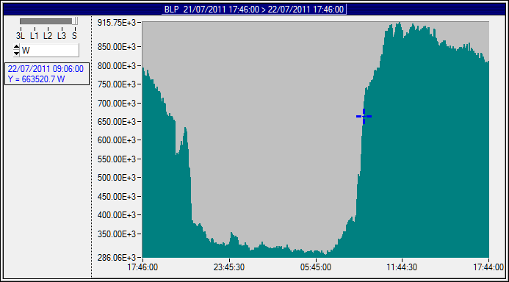
Consumption Profile – 24 hr
Notes:
Determine the best close for your audience and your presentation. Close with a summary; offer options; recommend a strategy; suggest a plan; set a goal. Keep your focus throughout your presentation, and you will more likely achieve your purpose.

Slide 14
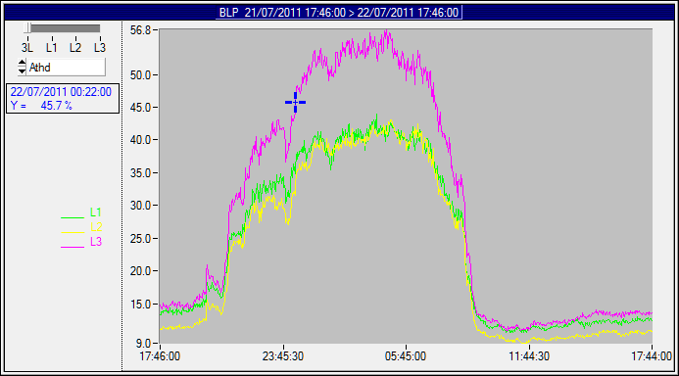
Current Harmonics
Notes:
Determine the best close for your audience and your presentation. Close with a summary; offer options; recommend a strategy; suggest a plan; set a goal. Keep your focus throughout your presentation, and you will more likely achieve your purpose.

Slide 15
Thermal Imaging of Electrical System
Measure
Temperature profile of electrical panels / connections with Thermal Imager Camera
Outcome
Identification of Hot Spots
The purpose is to identify hot spot due to localized heating; which could lead to failure / accidents. The corrective actions would ensure safe operation but may not necessarily result in energy saving.
Notes:
Determine the best close for your audience and your presentation. Close with a summary; offer options; recommend a strategy; suggest a plan; set a goal. Keep your focus throughout your presentation, and you will more likely achieve your purpose.

Slide 16
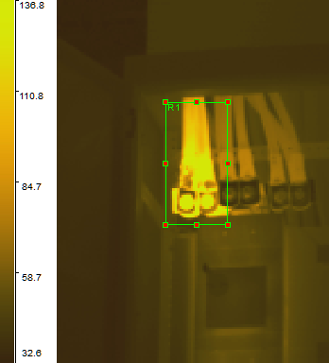
Thermal Imaging of Electrical System
Notes:
Determine the best close for your audience and your presentation. Close with a summary; offer options; recommend a strategy; suggest a plan; set a goal. Keep your focus throughout your presentation, and you will more likely achieve your purpose.

Slide 17
Energy Accounting
Prepare break up of energy consumption by
  Computing consumption of the respective area / equipment.
  Noting down operating period.
  Take data from various sub-meters
  Logging the data for predetermined period
Compare total consumption as estimated above with actual consumption to ascertain
  “Unaccounted” or “Miscellaneous” portion of the consumption
Analyze consumption pattern

Slide 18
Energy Accounting / Balancing

Slide 19
Refrigeration Compressors
Measure
Velocity of liquid to determine flow rate through chiller
Differential Temperature across chiller
Power drawn by compressor motor
Note down Motor Efficiency, Specific gravity and Specific heat of Liquid, Speed of Compressor
Outcome
Operating capacity & Specific Power Consumption
Recommended Specific Power at operating / design parameters
Steps to achieve the recommended / design parameters
Potential saving with cost benefit analysis
Notes:
Determine the best close for your audience and your presentation. Close with a summary; offer options; recommend a strategy; suggest a plan; set a goal. Keep your focus throughout your presentation, and you will more likely achieve your purpose.

Slide 20
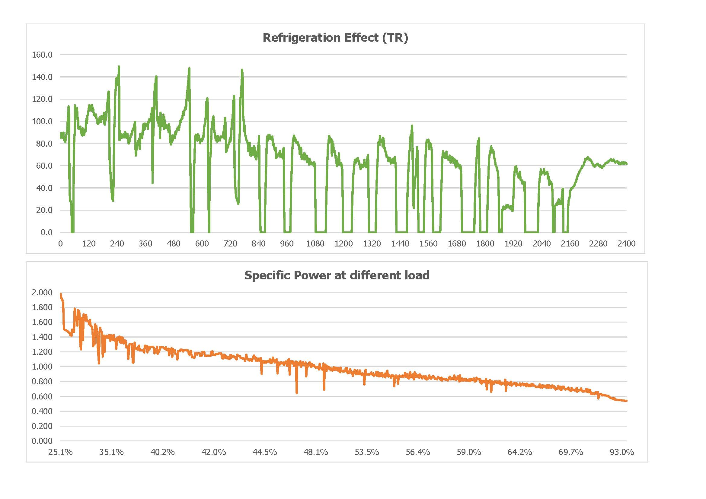
Notes:
Determine the best close for your audience and your presentation. Close with a summary; offer options; recommend a strategy; suggest a plan; set a goal. Keep your focus throughout your presentation, and you will more likely achieve your purpose.

Slide 21
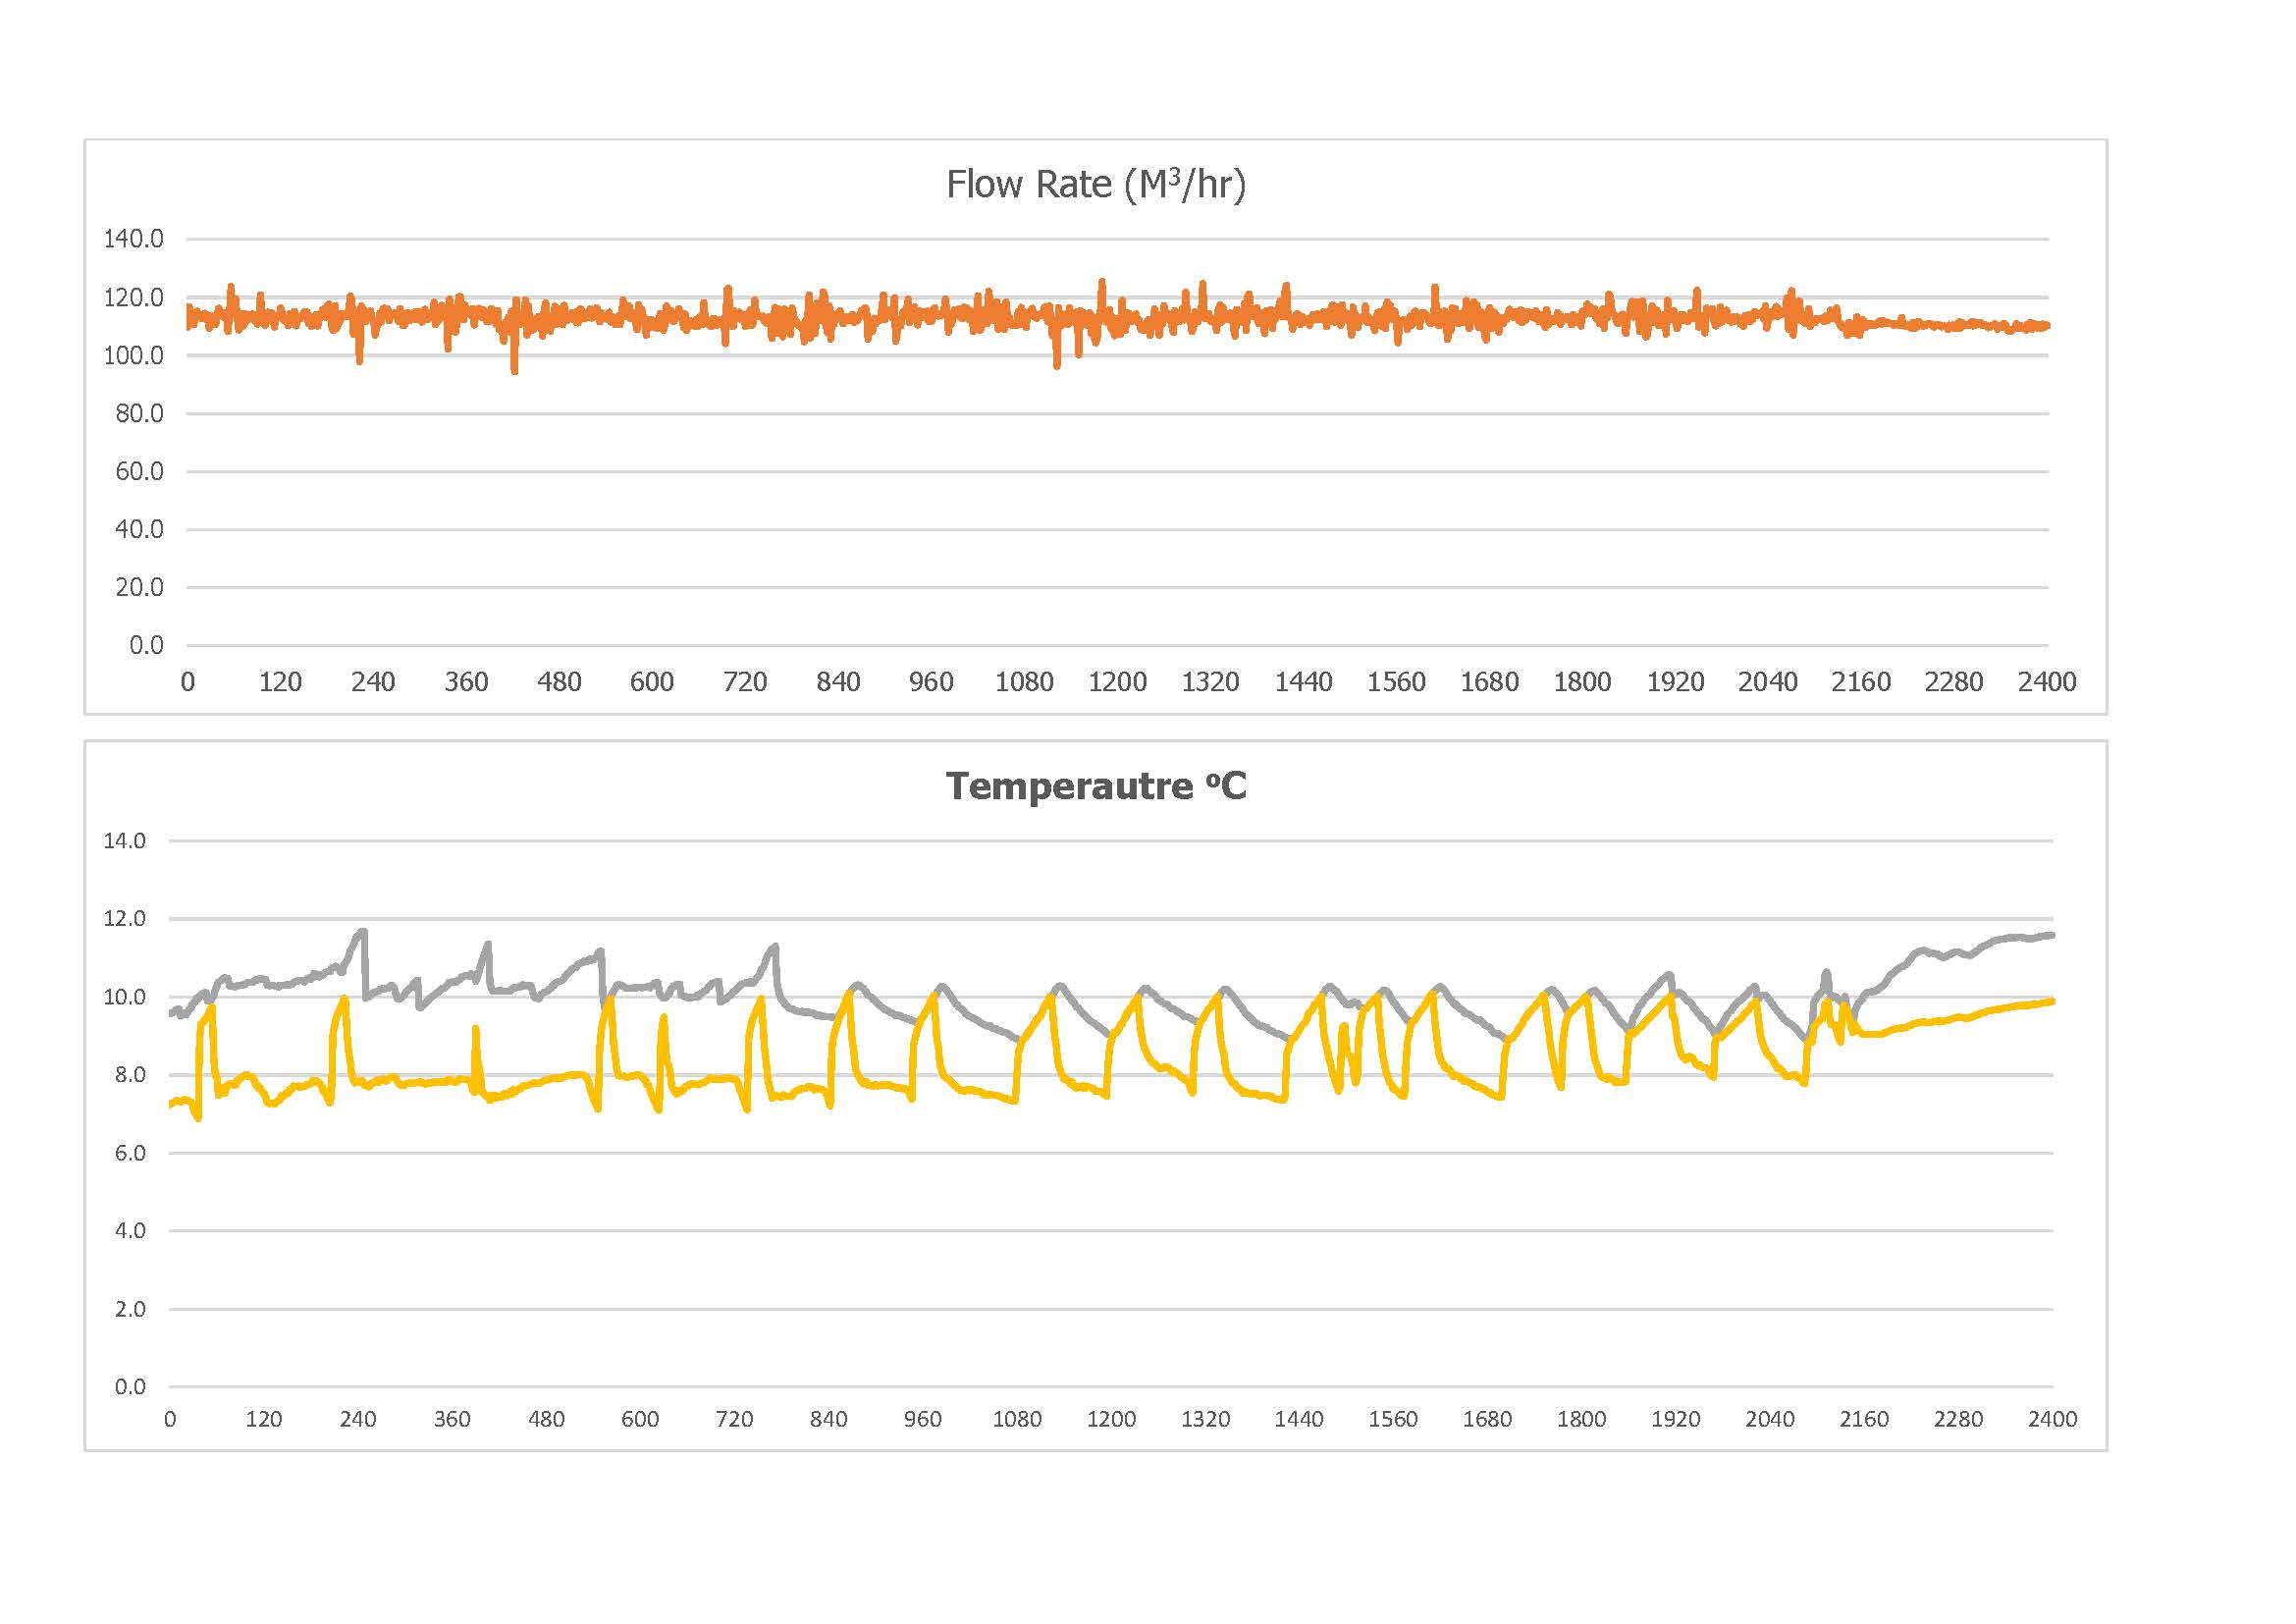
Notes:
Determine the best close for your audience and your presentation. Close with a summary; offer options; recommend a strategy; suggest a plan; set a goal. Keep your focus throughout your presentation, and you will more likely achieve your purpose.

Slide 22
Refrigeration Compressors
Sr No | Description | ChWC – 11 100 TR
1 | Start Time | January 1st, at 20:00 Hr
2 | End Time | January 2nd, at 20:00 Hr
3 | Duration | 24 Hours
4 | Inlet Temperature | 13.0 ºC
5 | Outlet Temperature | 12.2 ºC
6 | Flow Rate | 80.4 M³/hr
7 | Refrigeration Load - Maximum | 83.6 TR 83.6% of Rated
8 | Refrigeration Load - Average | 33.8 TR 33.8% of Rated
9 | Power Consumption – Average | 19.4 kW
10 | Specific Power Consumption – Average | 0.943 kWh/TR
11 | Refrigeration Compressor – On duration | 60.4%
12 | Average output of Refrigeration Compressor | 20.46 TR 20.5% of Rated

Slide 23
Ductable Split AC Units – Water cooled

Slide 24
Ductable Split AC Units – Water cooled

Slide 25
Pumps
Measure
Velocity of liquid to determine flow rate
Differential Pressure
Power drawn by motor
Note down Motor Efficiency and Specific gravity of Liquid
Outcome
Present pump efficiency
Operating parameters – Flow, differential head and power.
Recommended Efficiency at Operating parameters
Steps to achieve the recommended parameters
Potential saving with cost benefit analysis
Notes:
Determine the best close for your audience and your presentation. Close with a summary; offer options; recommend a strategy; suggest a plan; set a goal. Keep your focus throughout your presentation, and you will more likely achieve your purpose.

Slide 26
Pumps
Description | Units | WC-1 - M-1 | WC-1 - M-2 | WC-1 - M-3 | WC-1 - M-4
Actual Parameters
Cost of Power | Rs/kWh | 2.56 | 2.56 | 2.56 | 2.56
Operation | Hr/day | 24 | 24 | 24 | 24
 | Day/Year | 360 | 360 | 360 | 360
Flow rate | M3/hr | 878 | 917 | 865 | 898
Differential Head | M | 33 | 33 | 34 | 33
Motor Power | kW | 140 | 124 | 155 | 145
Pump Efficiency | % | 63% | 74% | 57% | 62%
Recommended Parameters
Head | M | 34 | 34 | 34 | 34
Flow rate | M3/hr | 900 | 900 | 900 | 900
Pump Efficiency | % | 85% | 85% | 85% | 85%
Shaft Power | Bkw | 98.1 | 98.1 | 98.1 | 98.1
Motor Power | kW | 109.0 | 109.0 | 109.0 | 109.0
Economics
Loss | kW | 31.0 | 15.0 | 46.0 | 36.0
 | kWh/year | 267911 | 129671 | 397511 | 311111
 | Rs/year | 685851 | 331957 | 1017627 | 796443
Notes:
Determine the best close for your audience and your presentation. Close with a summary; offer options; recommend a strategy; suggest a plan; set a goal. Keep your focus throughout your presentation, and you will more likely achieve your purpose.

Slide 27
Illumination & Indoor Air Quality
Illumination Level
Temperature
Relative Humidity (RH)
Carbon dioxide (CO₂) contents
Notes:
Determine the best close for your audience and your presentation. Close with a summary; offer options; recommend a strategy; suggest a plan; set a goal. Keep your focus throughout your presentation, and you will more likely achieve your purpose.

Slide 28
Notes:
Determine the best close for your audience and your presentation. Close with a summary; offer options; recommend a strategy; suggest a plan; set a goal. Keep your focus throughout your presentation, and you will more likely achieve your purpose.

Slide 29
Notes:
Determine the best close for your audience and your presentation. Close with a summary; offer options; recommend a strategy; suggest a plan; set a goal. Keep your focus throughout your presentation, and you will more likely achieve your purpose.

Slide 30
Notes:
Determine the best close for your audience and your presentation. Close with a summary; offer options; recommend a strategy; suggest a plan; set a goal. Keep your focus throughout your presentation, and you will more likely achieve your purpose.

Slide 31
Notes:
Determine the best close for your audience and your presentation. Close with a summary; offer options; recommend a strategy; suggest a plan; set a goal. Keep your focus throughout your presentation, and you will more likely achieve your purpose.

Slide 32
Notes:
Determine the best close for your audience and your presentation. Close with a summary; offer options; recommend a strategy; suggest a plan; set a goal. Keep your focus throughout your presentation, and you will more likely achieve your purpose.

Slide 33
Distribution System
Heat Ingress – Cold Insulation, Openings in AC area
Leakages – Compressed Air
Pressure Drop – Pumping Systems, Compressed Air
Power Loss – Electrical Systems & Cabling
Notes:
Determine the best close for your audience and your presentation. Close with a summary; offer options; recommend a strategy; suggest a plan; set a goal. Keep your focus throughout your presentation, and you will more likely achieve your purpose.

Slide 34
Utilization
Over / Under Sized Equipment
  Pumps, refrigeration compressors, cooling towers
High Grade Energy for Low Grade Applications
  Compressed air for cleaning, brine in place of chilled water
Unwarranted & Rigid Specifications.
  Stringent hall Conditions, air conditioning / lighting in unoccupied area

Slide 35
Recovery of Waste Energy
Recovery from Hot / Cold Effluent
  Preheat water or process fluid, Precool fresh air

Slide 36
Cost of Energy
Avail Maximum Tariff Concessions & Benefits
  Unity PF, Night Operation, Bulk Discount, Bulk Purchases
Switchover to cheaper Fuel
  Electrical to fuel (LPG / HSD / Biofuel) heating / solar system, heat pump and/or de-superheater for hot water
Power Exchange
  Procuring power through power exchange

Slide 37
Renewable Energy
Solar Photovoltaic
Solar Thermal - Heating Applications
Rooftop Wind Turbines
Bio-methanation / Composting of Organic Waste

Slide 38
Thank
You!

